Slide 1


PREDICTING MOVIE POPULARITY
Creating model that make an impact.

Slide 2

The Presenters
ENDI FERNANDA W.
Diploma Jamu
Soon a Data Scientist
endifernanda1@gmail.com

Slide 3

Box Office Bomb
In the motion picture industry, a box-office bomb or box-office flop is a film that is considered highly unsuccessful or unprofitable during its theatrical run. Although any film for which the production and marketing costs exceed the combined revenue after release can be considered to have "bombed", the term is more frequently used on major studio releases that are highly anticipated and expensive to produce.

Slide 4
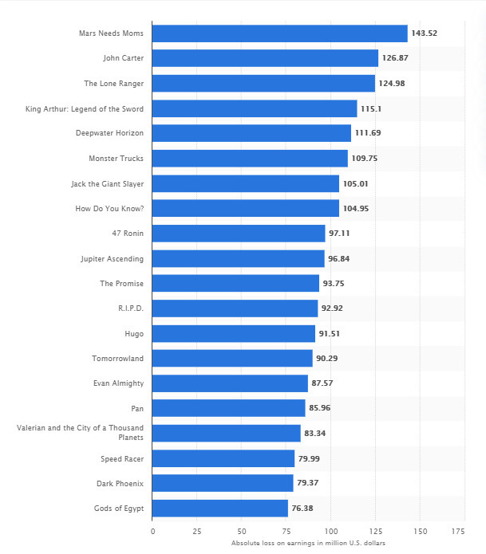
Biggest movie flops of all time as of February 2020, based on loss on worldwide earnings(in million U.S. dollars)
source = https://www.statista.com/statistics/655679/biggest-movie-flops-all-time/

Slide 5

Parasite
Budget₩20.5 billion(~US$11.4 million)
Box office $264.4 million
PARASITE is the film that took home the most awards at the Oscars 2020, winning four Academy Awards at tonight's Oscars including Best Picture, Directing, International Feature Film and Writing (Original Screenplay).

Slide 6




ABOUT THIS PROJECT
Data
PROBLEMS
The Dataset are downloaded from kaggle and has licensed CC0: Public Domain
Box Office Bomb / Flops make production company loses money
CLEANING & EDA
Machine Learning
Do Cleaning and EDA for the data and statistical test
Apply machine learning to data with
regression model

Slide 7
About Data
- `movie_title` = title of the movie as displayed on the Rotten Tomatoes website
- `movie_info` = brief description of the movie
- `critics_consensus` = comment from Rotten Tomatoes
- `content_rating` = category based on the movie suitability for audience
- `genres` = movie genres separated by commes, if multiple
- `directors` = name of director(s)
- `authors` = name of author(s)
- `actors` = name of actors
- `original_release_date` = date in which the movie has been released
- `streaming_release_date` = date in which the movie has been released for streaming
- `runtime` = movie runtume (in minutes)
- `production_company` = name of the production company
- `tomatometer_status` = tomatometer value of "Rotten" (less than 60% positive reviews), "Fresh" (at least 60% of positive reviews), and "Certified Fresh"
(at least 75% of positive reviews, at least 80 reviews of which at least 5 from top critics)
- `tomatometer_rating` = percentage of positive critic ratings
- `tomatometer_count` = critic ratings counted for the calculation of the tomatomer status
- `audience_status` = audience value of "Spilled" (less than 60% of users gave a rating of at least 3.5) or "Upright" (at least 60% of users gave a rating of at
least 3.5)
- `audience_rating` = percentage of positive user ratings
- `audience_count` = user ratings counted for the calculation of the audience status
- `tomatometer_top_critics_count` = count of top critic ratings
- `tomatometer_fresh_critics_count` = count of fresh critic ratings
- `tomatometer_rotten_critics_count` = count of rotten critic ratings

Slide 8
Modelling Strategy
What goes behind the screen
CLEANING DATA
BINNING
ENCODING
HYPERPARAMETER TUNING
Clean data with fillna and dropna
To bin the data for more accuracy
Encode with OneHotEncoder
Tune Model with best parameter

Slide 9
Conclussions
01
Modelling Report
We get good enough result to predict popularity .
Using XGB, train data result is 93.25 %
For testing data, The result is 90.28%
02
For Better Data
This model could be get better result if we do know spesifically about some features (budget, gross and worldwide gross).
And we could try GridSearchCV for every models.

Slide 10
Thank You

